Slide 1
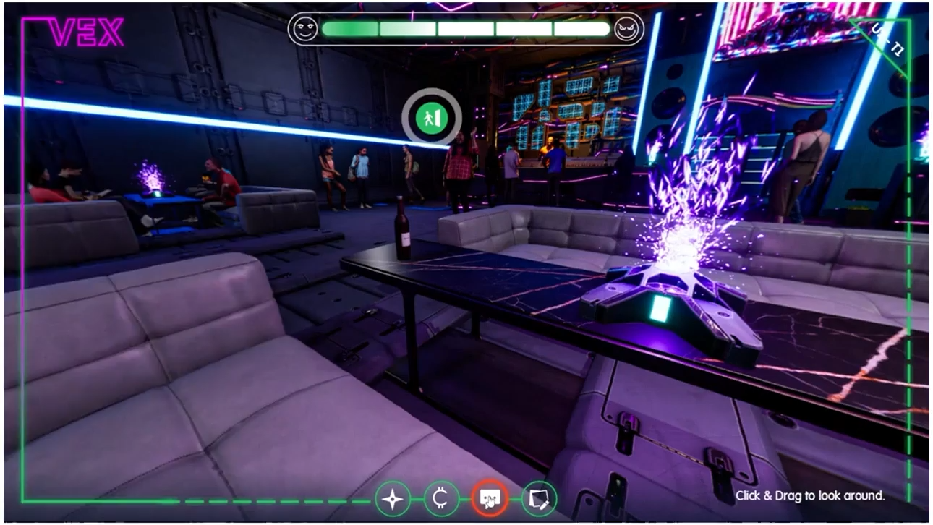
THE BOILER ROOM
Our Turnkey Solutions
Notes:
[Insert quick snapshot video of our nice elearning – showcase ... Quick and punchy]
2 minutes max
The real MAGIC, though, is how custom these solutions are.
Every project is built around your environment ... your operations, your culture, and the real challenges your teams face.
So whether it’s induction training for new staff, a compliance course, or safety simulations in VR, we tailor it to make it relevant, engaging, and impactful.
Our approach is also very performance-driven.
We're not just ticking boxes ... we want these solutions to make a difference on the ground:
safer behaviours,
smoother operations,
better decision-making.
We often use adult learning principles and Bloom’s Taxonomy as part of our methodology to make sure the learning sticks.
And lastly, everything is built to scale.
So if you need to roll out the same training across multiple sites, departments, or even adjust it for different user levels ... it’s designed to flex with you.
Whether it plugs into your current LMS, or runs offline via BoilerBox360, we make sure it's seamless.
That’s what we mean by turnkey. It’s smart, scalable, and stress-free.

